Slide 1
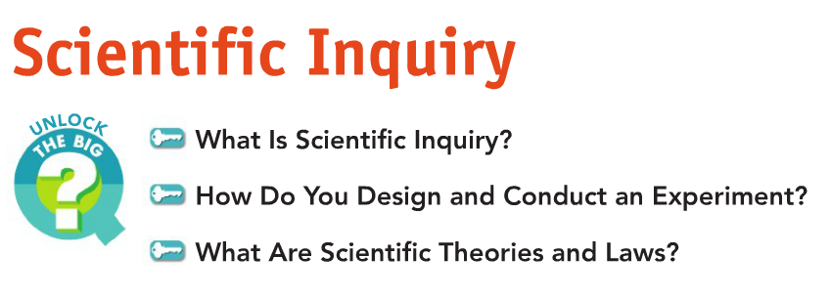
10/17/16
Initial Activity:
Do you think a bowling ball and an apple that are dropped from the same height at the same time will hit the ground at the same time?
Explain your answer.

Slide 2
Scientific Inquiry Begins!
Misconception: Heavier objects fall faster than lighter ones. This assumption is not true. They actually fall at the same rate, or with the same acceleration.
The misconception was introduced by a philosopher named Aristotle and accepted for more than 2,000 years.
In the late 1500s, Galileo Galilei discovered something different—all free-falling objects fall with the same acceleration. To prove this, Galileo performed a number of experiments. Galileo’s experiments involved rolling balls with different masses down a ramp called an inclined plane and making careful measurements.

Slide 3
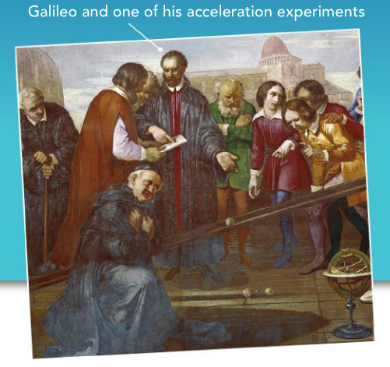
…Turn and Talk…
Discuss the following questions with your neighbor:
Why did Galileo perform experiments to see if all objects fall with the same acceleration?

Slide 4
What is Scientific Inquiry?
Thinking and questioning is the start of a scientific inquiry process.
- Scientific inquiry refers to the diverse ways in which scientists study the natural world and propose explanations based on the evidence they gather.
- Scientific inquiry often begins with a question about an observation. In trying to answer a question, you are developing a hypothesis. A hypothesis is a possible answer to a scientific question.

Slide 5
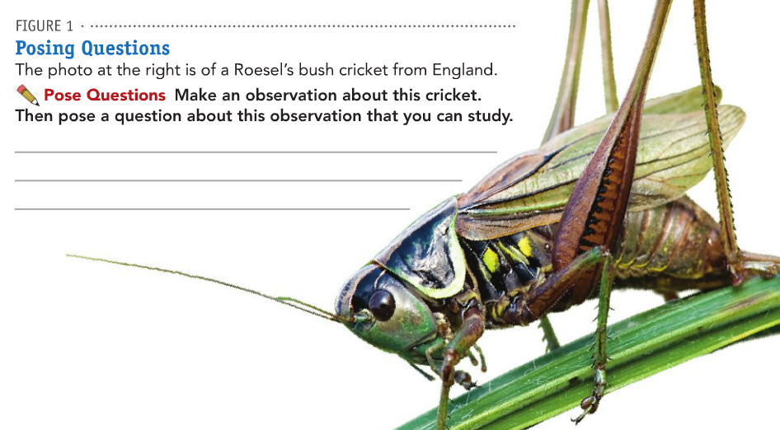

Slide 6
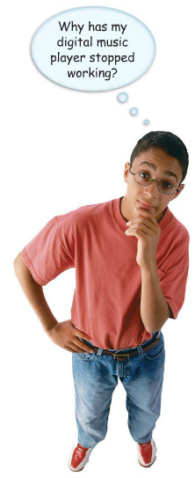
Problem: Why has my digital music player (ipod) stopped working?
Write down two possible hypotheses that might answer the student’s question.
Hypothesis sentence starters:
- I think that…
- If ...... Then…Because…

Slide 7
Reviewing Experiment Variables
The Manipulated Variable also known as the Independent Variable is the one thing purposely changed in an experiment to test a hypothesis.
The Responding Variable also known as the Dependent Variable is what is being measured in the experiment (the data you collect).
All other variables (factors that can change in an experiment) must be controlled or kept constant.

Slide 9
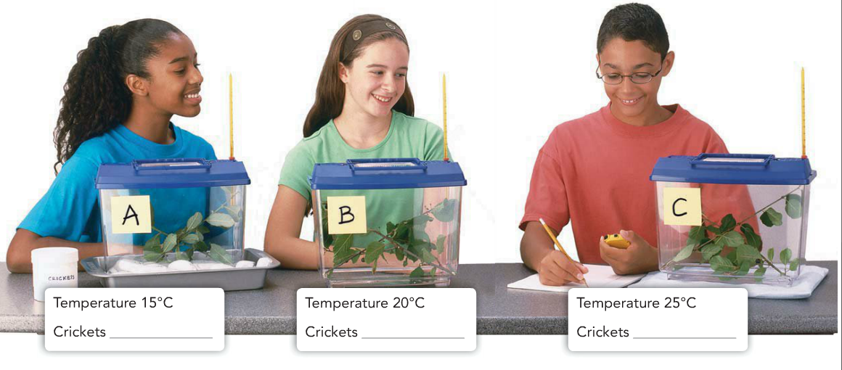

Slide 10
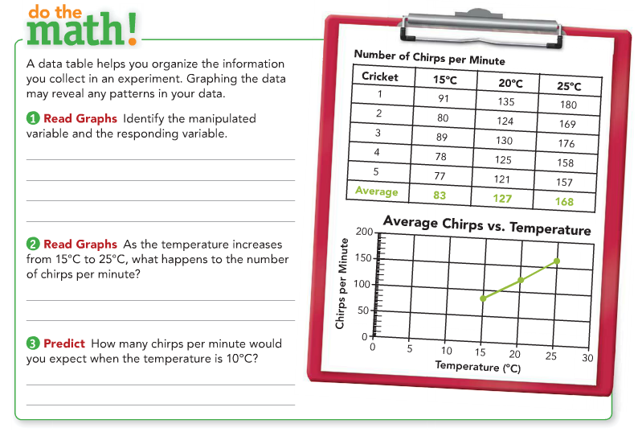

Slide 11
10/20/16
Initial Activity:
Henri Becquerel was a pioneer for scientific exploration.
Read the passage about him.
On a separate sheet of loose leaf paper, answer the questions in full sentences.
** You DO NOT need to copy the questions**

Slide 12
An Enlightening Discovery
1. What was Becquerel’s original hypothesis?
2. How was Becquerel convinced AT FIRST that his hypothesis was supported (correct?)
3. What observation caused Becquerel to pose another question?
4. What discovery did Becquerel make by accident?
5. How did Becquerel discover that uranium gives off a type of radiation?

Slide 13
Analyzing Data:
1. Does this data support the hypothesis that crickets chirp more in warmer temperatures. Explain your answer.
2. If this was your data, what might you do next?
3. Challenge- Can you draw a conclusion from this data? Why or why not?

Slide 14
What are scientific laws and theories?
A scientific theory is a well-tested explanation for a wide range of observations and experimental results.
A scientific law is a statement that describes what scientists expect to happen every time under a particular set of conditions.
Unlike a theory, a scientific law describes an observed pattern in nature without attempting to explain it.

Slide 15
Scientific Inquiry Main Ideas
Read the key concept summary page to review main ideas.
On a SEPERARE sheet of Loose Leaf Paper, answer the questions in Part 1 in full sentences. For the FILL IN THE BLANK section, you need to only write the correct Vocabulary Word (on the loose leaf paper.)

