Slide 1
Teachers:
Mrs. Patti (601, 602, 603, 604)
Mr. Watkins (603 & 605)
Ms. Velarde (601)
Welcome 6th grade Science Parents and Guardians

Slide 2
Contact Information
Mrs. Patti- patti@kecss.net
Mr. Watkins- watkins@kecss.net
Ms. Velarde- velarde@kecss.net
Class Website:
www.mrspatti.yolasite.com

Slide 3

Science Grading Policy
Exams & Quizzes: 35%
Class Work/ Class Participation: 25%
Homework 15%
Projects/Labs: 25%

Slide 4
How can I monitor my student’s grades?
Please visit www.jupitered.com
All students were given log in information for both student and parent access on the first day of school.
All tests, quizzes, hw assignments, missing work, announcements and reminders are posted on this site.

Slide 5
Main Topics Covered in 6th Grade Science
The Scientific Method/Computer Science
Forces & Energy
Weather & The Earth’s Atmosphere
Life’s Structure (Cells) and Classification
Interactions Of Life (Food Chains, Symbiosis) & Ecosystems
** Technology Infused Lessons and Units**

Slide 6
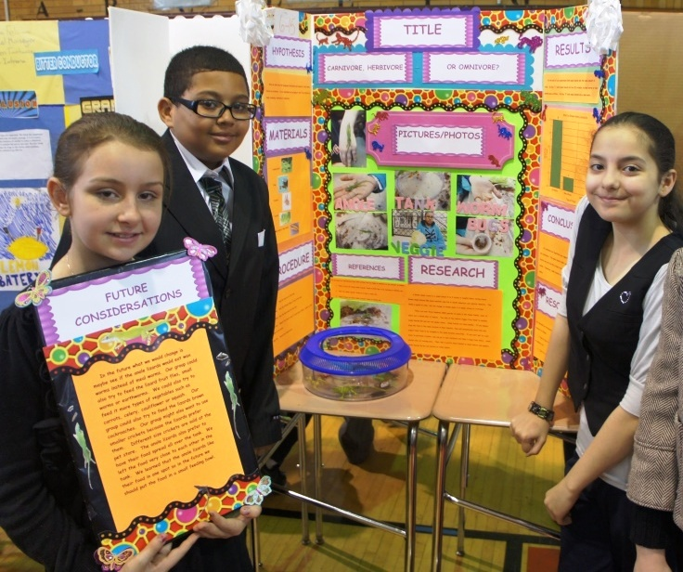
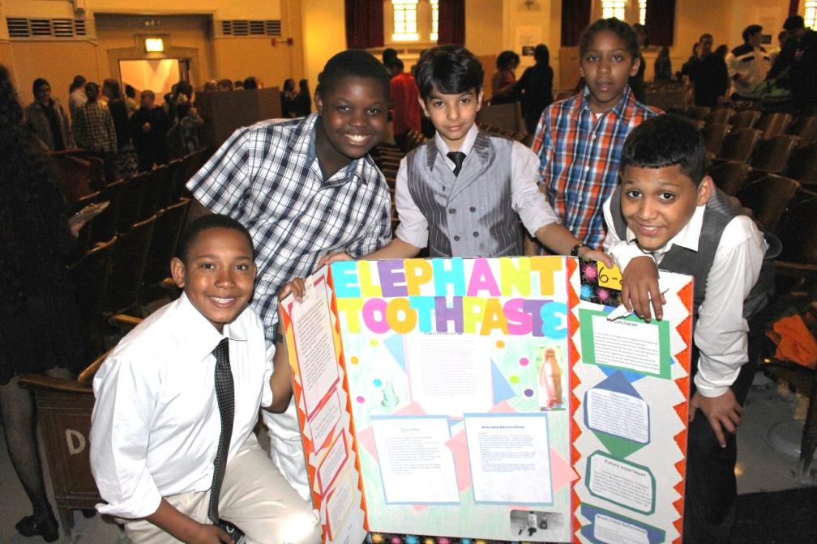
Will my child be asked to complete a science fair project?
Ever year there is a school wide science fair.
Students will work in groups to complete projects that will be presented at the fair.
Almost all of the typing and decoration of the display board is done in school while the actual experiment is to be completed at home.

Slide 7
Thank you for visiting me and taking interest in your child’s science class!
I will open the floor for any questions, concerns, or comments.

